Slide 1
Cam/Iconic Saga Youtube
Iconic Saga 2022

Slide 2
Main points
Consistent Uploads
Clear thumbnail strategy
Shorts
Channel genres we should continue pursuing
Old footage
Brainstorm

Slide 3

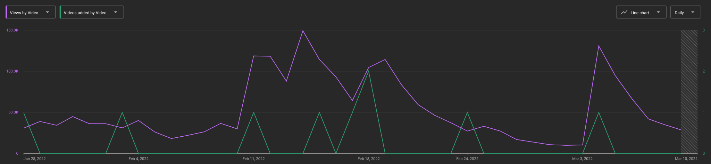
Consistent uploads
Uploads directly correlate to more views. Consistency is key
The purple downward slope was a 2 week period where we didnt upload
Playing keep up with a beachball

Slide 4
Consistency thoughts
Some of our uploads are a heavy lift, what can we create thats low lift? (added to brainstorm)
Funky Friday interview - HEAVY🏋️
Funky Friday in the car - LOW🎈
Filming a new workout video - HEAVY🏋️
Compilation of old workouts - LOW🎈
Uploading once per week should be our MINIMUM

Slide 5
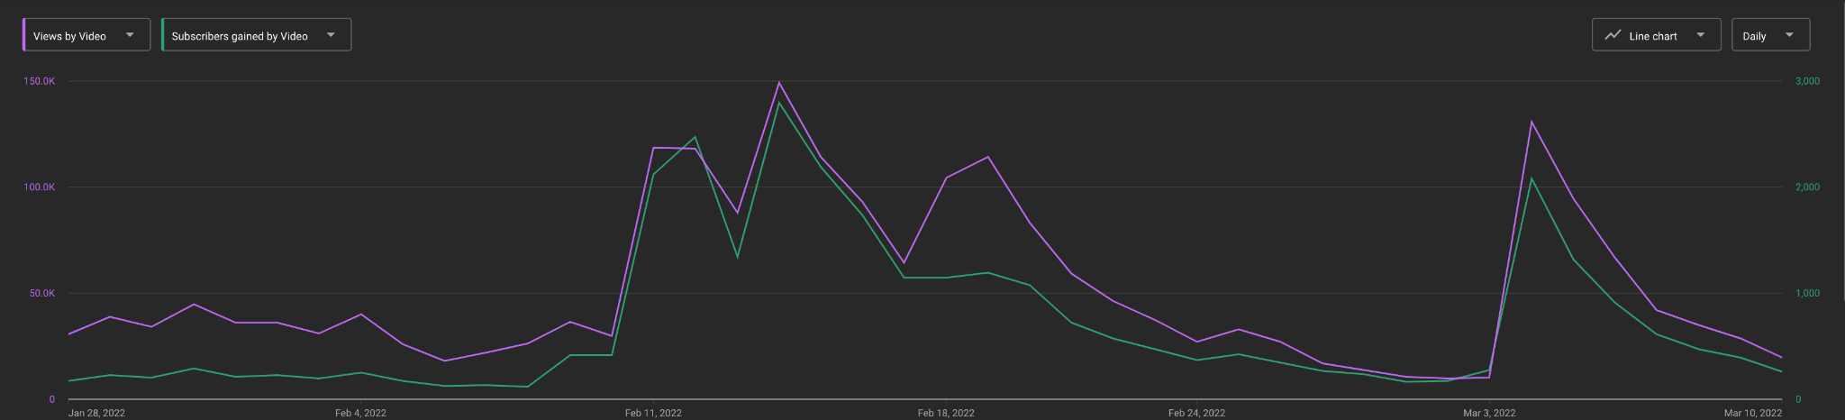
Consistency data - subscribers
Views per day with subscribers per day

Slide 6
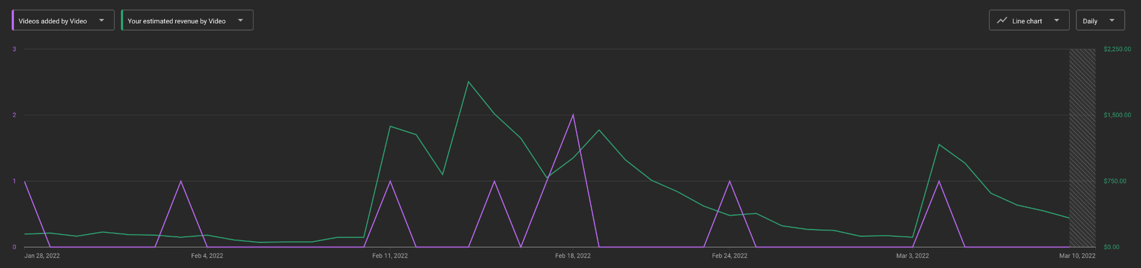
Consistency data - $
Videos added with estimated revenue

Slide 7
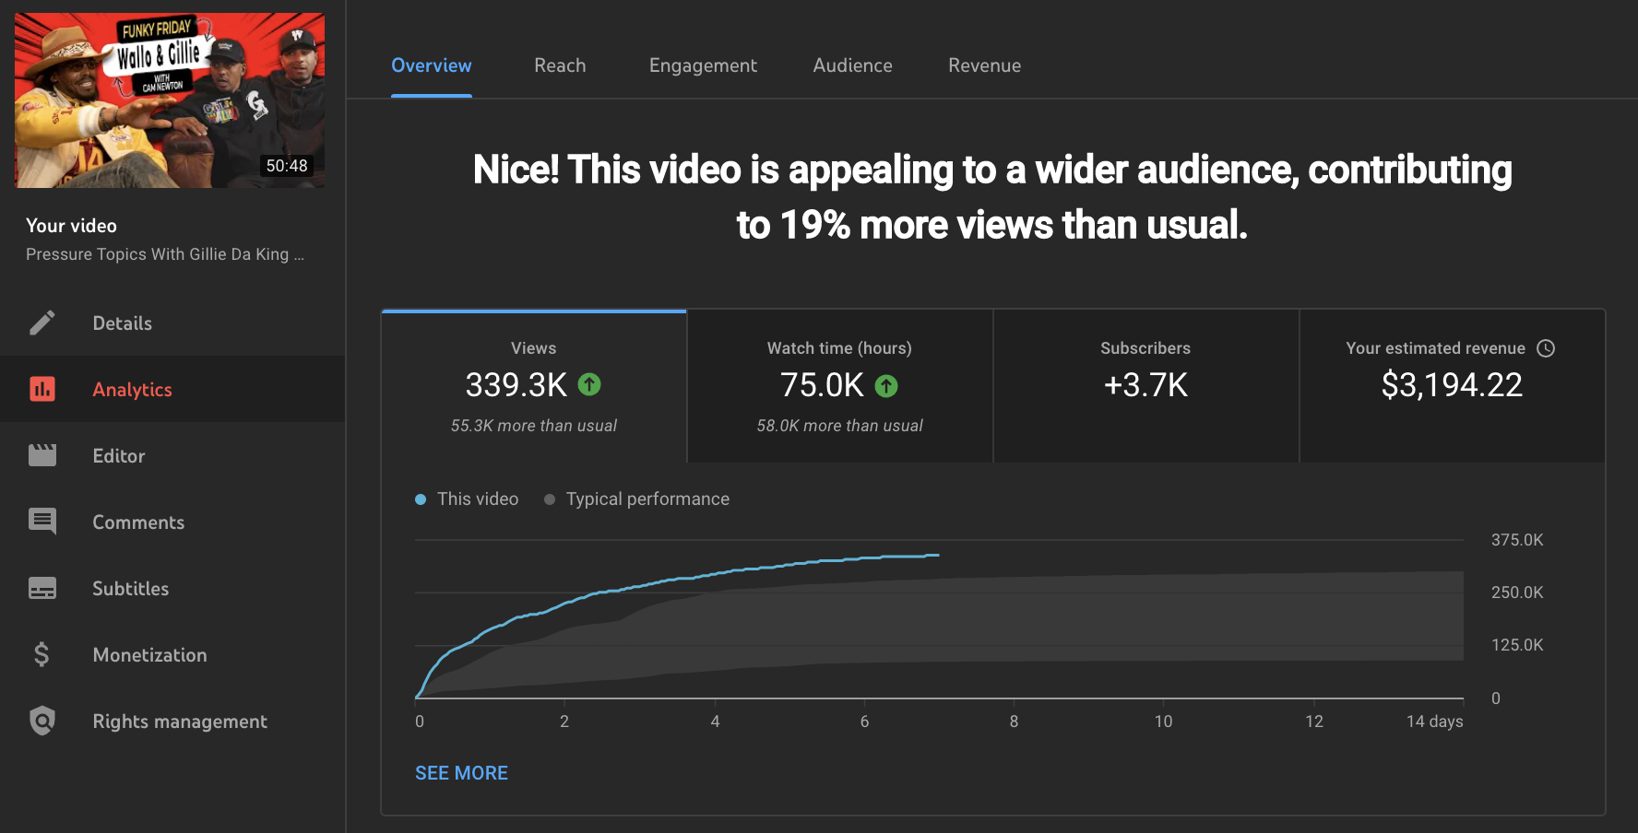
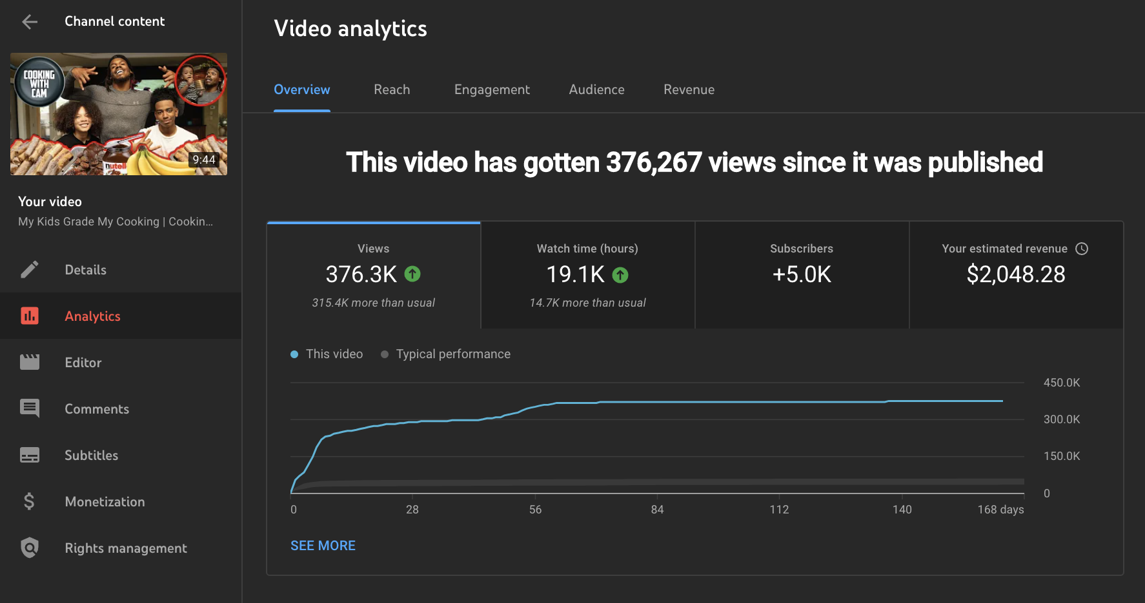
Consistency data - Heavy lift 🏋️ vs Low lift 🎈
Heavy lift
Filmed on set then edited for upload
Low Lift
Footage pulled from Hard drive & sent to editor

Slide 8
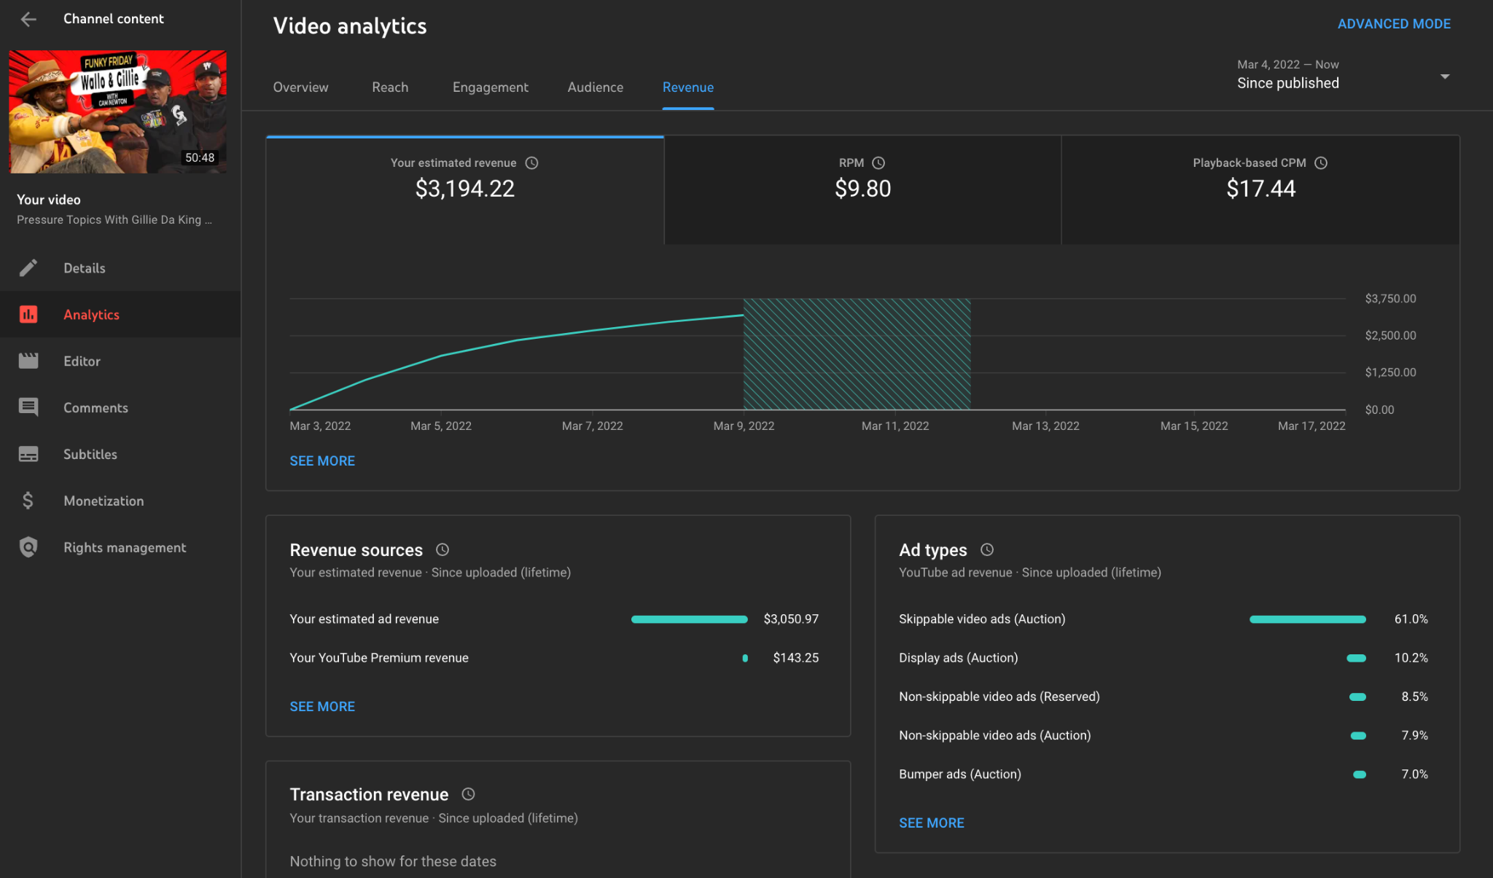
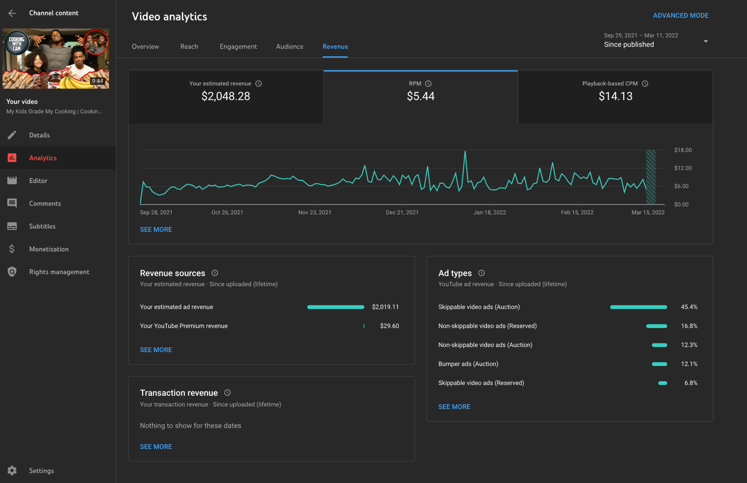
Side note the $ difference
50 minutes
4 mid roll ads
9 minutes
2 mid roll ads
2 m

Slide 9
Thumbnail strategy
Cams face
Expressive face relevant to title (Happy, sad, excited, intense)
Darken hair, brighten teeth, sharpen eyes, blur background
Creator/idea Hacking (added to brainstorm)
The use of a prominent person/idea directly add more views
The video pics up impressions from their audience

Slide 10

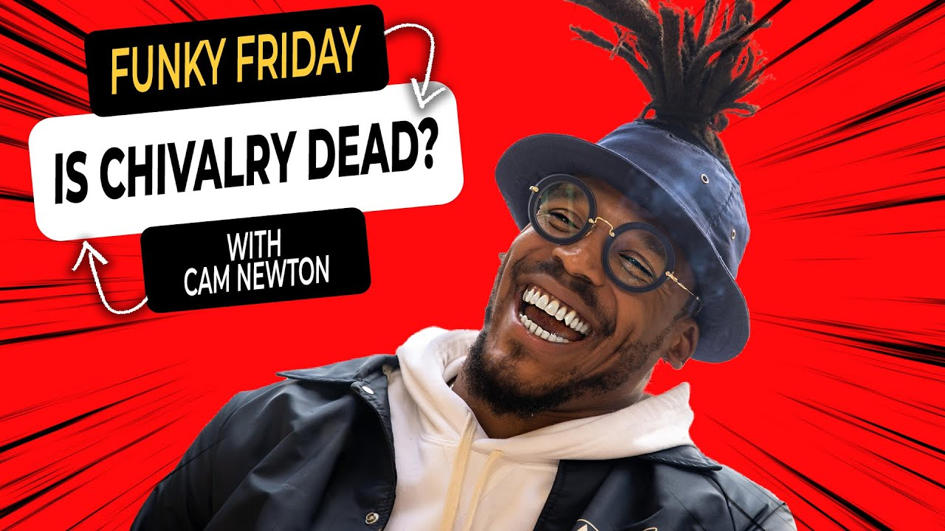
Cams face
1
2

Slide 11
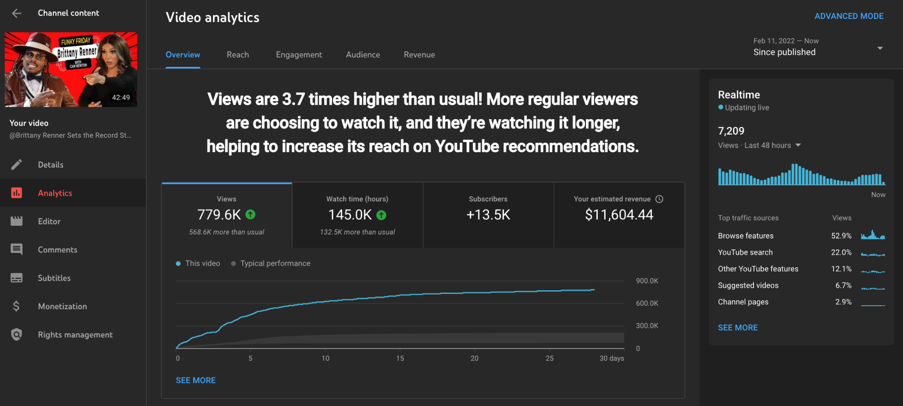
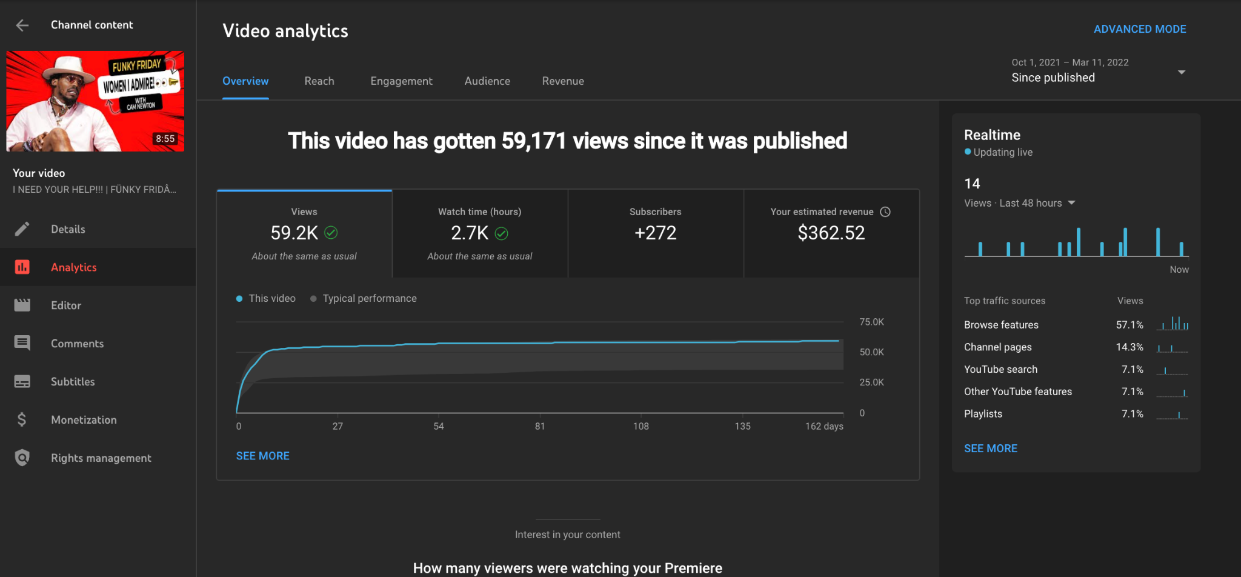
Creator Hacking
Almost everytime we add another prominent person, views are WAY up
Missed opportunity. Thumbnail said “women I admire” Which women???
Beyonce, Tiffany Haddish, Oprah, Amber Rose

Slide 12
Shorts
Youtube treats the upload as a “upload”
No thumbnail or description needed
1 minute
Fully monetized
Channels can receive between $100–$10,000 each month. Bonuses are adjusted based on the location of a creator’s audience. As a result, the viewership and engagement needed to qualify may differ between creators. - YouTube Support
Clips, funny moments, IG stories? (added to brainstorm)

Slide 13
Genres
Funky Friday
NFL
Workouts
Cooking With Cam
Family uploads
Travel/ Vlogs
Fashion
Anything else we should have in here? (added to brainstorm)

Slide 14
Old footage
How can we justify telling old stories
Intro
From the hard drive
Voice memo
Vintage tv
...?
Talking head
Filmed on iphone
Filmed in front of solid bg
animation?
Old workouts
Old football games
Old travel stories
Old vacations
Old trips
Hard Drive

Slide 15
YouTube brainstorm topics
Consistent uploads
what could we add thats low lift?
What could we add thats heavy lift?
Creator Hacking
Who & what
Shorts
What could we create
Who edits this? Hero editor or passed off?
Genres?
What are you already doing we could tell stories about?
Old footage
Hard drive link

